Slide 1
Precursor Material
Impact events are caused by the collision of large meteoroids, asteroids or comets (bolides) with Earth and may sometimes be followed by mass extinctions of life
These events may have been the cause of massive climate change or the extinction of large numbers of plant and animal species.

Slide 2
The Tunguska Event
The Effect of Meteorite Impact

Slide 3
Introduction
The Tunguska Event was a massive explosion that occurred near the Podkamennaya Tunguska River, at around 7:14 a.m. on June 30, 1908
It is believed to be the largest impact event on land in Earth's recent history
Although the cause is the subject of some debate, the explosion was most likely caused by the air burst of a large meteoroid or comet fragment at an altitude of 5–10 kilometres (3–6 miles) above Earth's surface. Different studies have yielded a general agreement that it was a few tens of meters across.
Although the meteor or comet burst in the air rather than directly hitting the surface, this event is still referred to as an impact. Estimates of the energy of the blast range from 10-15 megatons of TNT - roughly equal to the United States' Castle Bravo thermonuclear explosion or about 1000 times as powerful as the bomb dropped on Hiroshima, Japan!

Slide 4
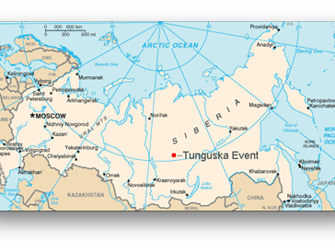
Approximate location of the Tunguska event in Siberia.

Slide 5
Witnessing the Impact
Many eyewitness accounts provide evidence
At around 7:17 a.m. local time, Tungus natives in the hills northwest of Lake Baikal observed a column of bluish light, nearly as bright as the Sun, moving across the sky. About 10 minutes later, there was a flash and a sound similar to artillery fire. Eyewitnesses closer to the explosion reported the sound source moving east to north. The sounds were accompanied by a shock wave that knocked people off their feet and broke windows hundreds of miles away.

Slide 6

View from Vanavara trading post, at the moment of the explosion.
A painting 60km South of Ground Zero

Slide 7
Postponed Discovery
There was little scientific curiosity about the impact at the time, possibly due to the isolation of the Tunguska region. If there were any early expeditions to the site, the records were likely to have been lost during the subsequent chaotic years — World War I, the Russian Revolution of 1917, and the Russian Civil War.
The first recorded expedition arrived at the scene more than a decade after the event. In 1921, the Russian mineralogist Leonid Kulik, visiting the Podkamennaya Tunguska River basin as part of a survey for the Soviet Academy of Sciences, deduced from local accounts that the explosion had been caused by a giant meteorite impact. He persuaded the Soviet government to fund an expedition to the Tunguska region, based on the prospect of meteoric iron that could be salvaged to aid Soviet industry.
Kulik's party reached the site in 1927. To their surprise, no crater was to be found. There was instead a region of scorched trees about 50 kilometres across. A few near ground zero were still strangely standing upright, their branches and bark stripped off. Those farther away had been knocked down in a direction away from the center.

Slide 8
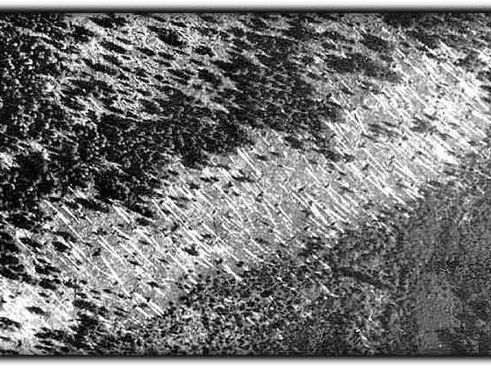
The parallel fallen trees indicate the direction of the blast wave.
Portion of one of the photos from Kulik's aerial photographic survey (1938) of the Tunguska region.

Slide 9
Speculative hypotheses
Scientific understanding of the behavior of meteorites in the Earth's atmosphere was much sparser during the early decades of the 20th century. Due to this lack of knowledge, as well as a paucity of scientific data about Tunguska due to Soviet secrecy during the Cold War, a great many other hypotheses for the Tunguska event have sprung up, none of which are accepted by the scientific community.
Example hypotheses: Natural H-bomb, Black hole, Antimatter, UFO crash, Geophysical hypotheses, and the End of the World

Slide 10
Later Discoveries
Expeditions sent to the area in the 1950s and 1960s found microscopic silicate and magnetite spheres in siftings of the soil. Chemical analysis showed that the spheres contained high proportions of nickel relative to iron, which is also found in meteorites, leading to the conclusion they were of extraterrestrial origin.
Chemical analysis of peat bogs from the area also revealed numerous anomalies considered consistent with an impact event. The isotopic signatures of carbon, hydrogen, and nitrogen at the layer of the bogs corresponding to 1908 were found to be inconsistent with radioactive decay from the natural isotopic ratios found on Earth. The region of the bogs containing these anomalous signatures also contains an unusually high proportion of iridium, similar to the iridium layer found in the K–T boundary. These unusual proportions are believed to result from debris from the impacting body that deposited in the bogs. The nitrogen is believed to have been deposited as acid rain, a suspected fallout from the explosion.

Slide 11
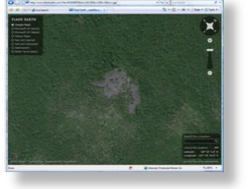
FlashEarth satellite image at ground zero

Slide 12
Worldwide Effects
The explosion registered on seismic stations across Eurasia. It is estimated that the earthquake from the blast would have measured 5.0 on the Richter scale (which was not yet developed at the time). An explosion of this magnitude is capable of destroying a large metropolitan area.
It also produced fluctuations in atmospheric pressure strong enough to be detected in Great Britain. Over the next few weeks, night skies were aglow such that one could read in their light, from dust suspended in the stratosphere by the explosion. In the United States, the Smithsonian Astrophysical Observatory and the Mount Wilson Observatory observed a decrease in atmospheric transparency that lasted for several months.

Slide 13
Evenks/Tungas
The Evenks or Tungus are a Tungusic people of Northern Asia.
In Russia, the Evenks are recognized as one of the Indigenous peoples of the Russian North, with a population of 35,527 (2002 Census).
They speak in their own native language Evanki and have adopted Russian
Prior to contact with the Russians, the religion of the Evenks was shamanism. Although many of them have adopted Lamaism (which is the mainstream form of Tibetan Mahayana Buddhism) the Evenks nominally Orthodox Christian people.

Slide 14
Pop Culture
Due to the aforementioned speculative hypotheses, this event served as a hub for science fiction
In the 2008 film Indiana Jones and the Kingdom of the Crystal Skull , Irina Spalko reminds Indy about the Tunguska explosion where a specimen was found
In the 2007 video game Assassin's Creed, the Tunguska Incident is said to be the result of an attack by Assassins
In a Marvel Comics trilogy of publications entitled Ultimate Nightmare (2004-2005), the Ultimate universe characters confront the mystery of the event, linking it to an alien encounter with the Ultimate version of Galactus.

Slide 15
References
Tunguska Event. (2004, July 22). In Wikipedia, the free encyclopedia. Retrieved July 15, 2008, from http://en.wikipedia.org/wiki/Tunguska_Event
Goebel, Greg (2008, February 01). Vectorsite. Retrieved July 15, 2008, from Earth Impacts Web site: http://www.vectorsite.net/taimpact.html
pictures from:
http://www.psi.edu/projects/siberia/siberia.html
http://8r13n.wordpress.com/2007/03/14/the-tunguska-event/

